Slide 1





SPOTIFY MUSIC RECOMMENDATION SYSTEM
Team :NAGARAJAN M & nagamurugan525@gmail.com
Guide: (P.Raja, Master Trainer )
Disclaimer: The content is curated for educational purposes only.
Notes:
Slides: Prepare a short slide deck (10-12 slides) summarizing the project objectives, methodology, and key results.

Slide 2
OUTLINE
Abstract
Problem Statement
Proposed System/Solution
Algorithm & Deployment
GitHub Link
Project Demo(photos / videos)
Conclusion
Future Scope
References

Slide 3
Abstract
This project creates a facial recognition system for real-time student concentration analysis using computer vision and machine learning. It provides instant feedback based on facial expressions to enhance focus during learning. Future improvements aim to address challenges like lighting sensitivity and pose variation.

Slide 4
Problem Statement
Develop a recommendation system for Spotify that suggests music tracks to users based on their interest of listening history and preferences. The system should utilize machine learning algorithms to analyze user behavior, track features, and similarities between users and tracks to generate accurate recommendations.
Recommend tracks based on the content of the music, such as genre, tempo, mood, and instrumentation. similarities between users and recommend tracks based on similar users' preferences.

Slide 5
Proposed Solution
A hybrid recommendation system for spotify could combine collaborative filtering with content based filtering,collaborative filtering would analyze user behavior and preferences to suggest music similar to what they already enjoy.
Content-based filtering would examine the audio features of songs (eg.tempo,genre,mood) to recommended tracks with similar attributes. This dual approach balances personalization and diversity in recommendations, enhancing user satisfaction.
Regular updates and user feedback loops would continuously improve the system’s accuracy and relevance

Slide 6
System Architecture
The system architecture consists of multiple components working together to enable real-time face recognition and concentration analysis. First, the face detection module captures and processes the student's facial features. Then, the face recognition module identifies the registered student. The concentration analysis module evaluates focus levels by analyzing facial cues like eye movement and head orientation. The system's database stores facial data and concentration scores, ensuring continuous updates. Finally, the user interface provides real-time feedback to students based on their concentration levels.

Slide 7
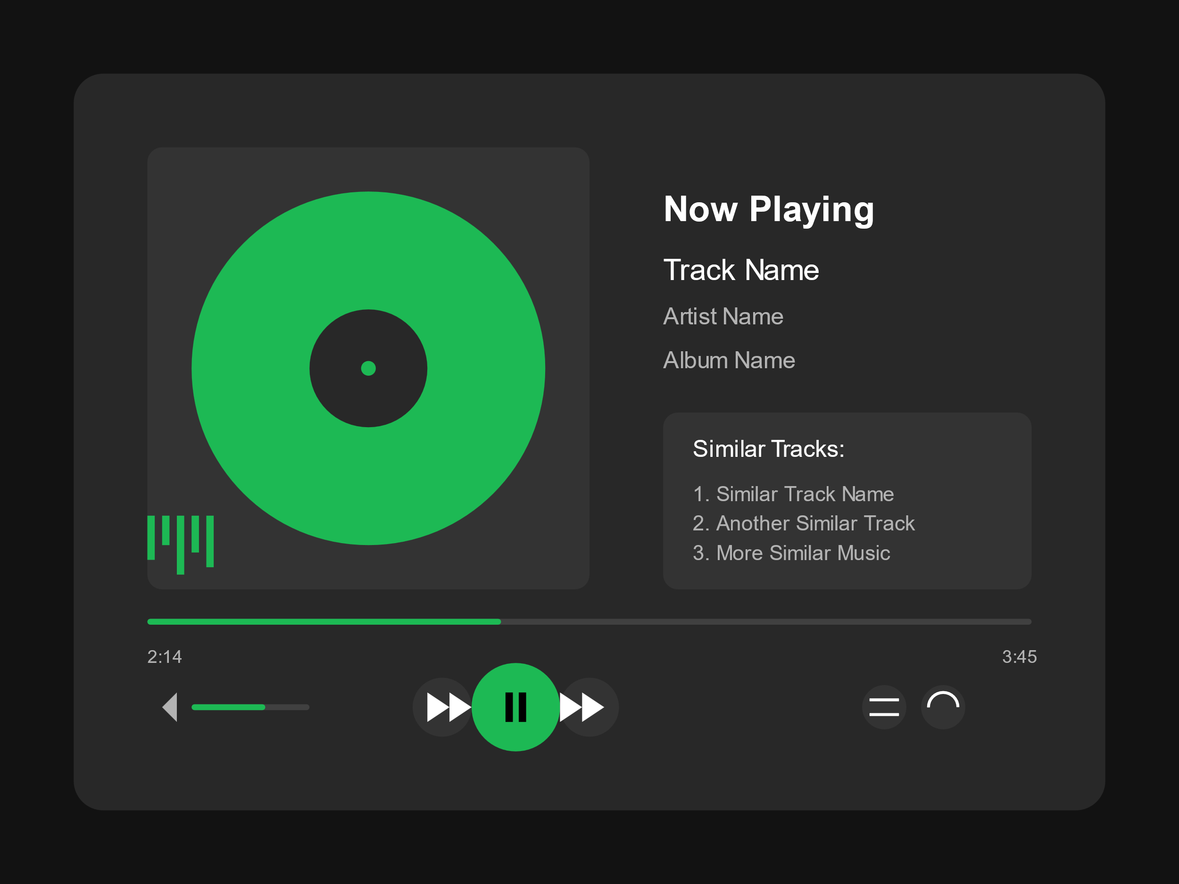
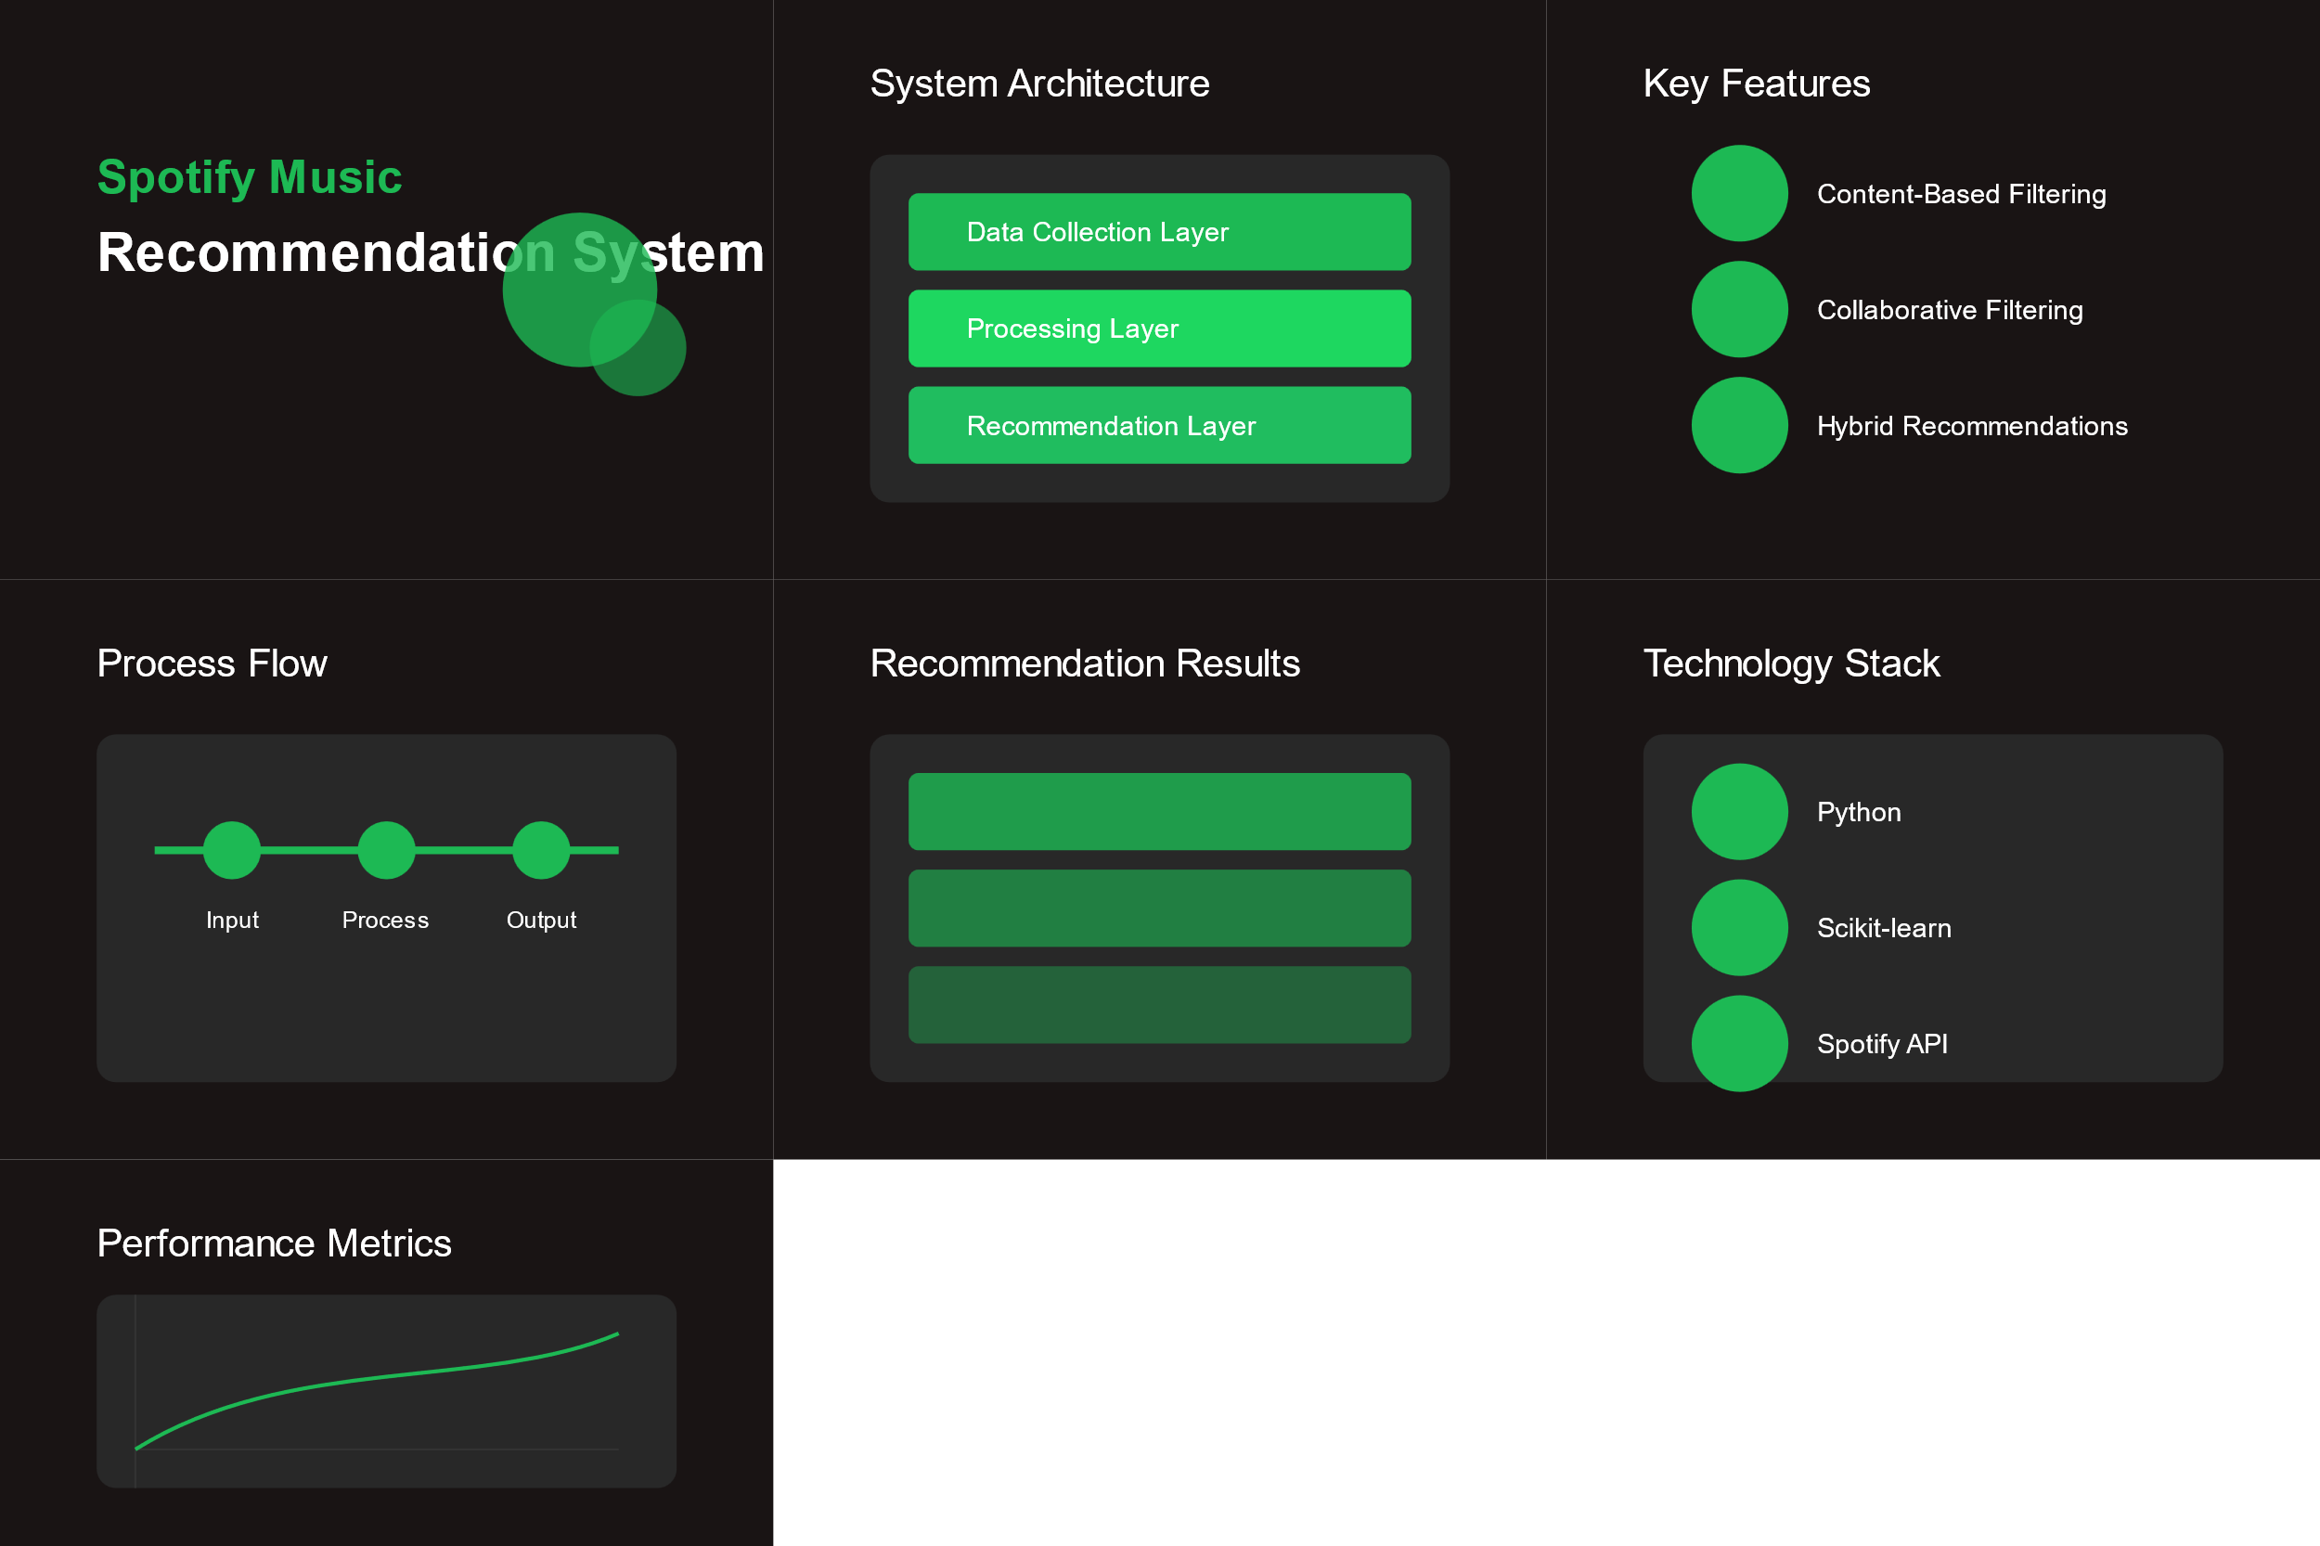
Live Demo of Project

Slide 8
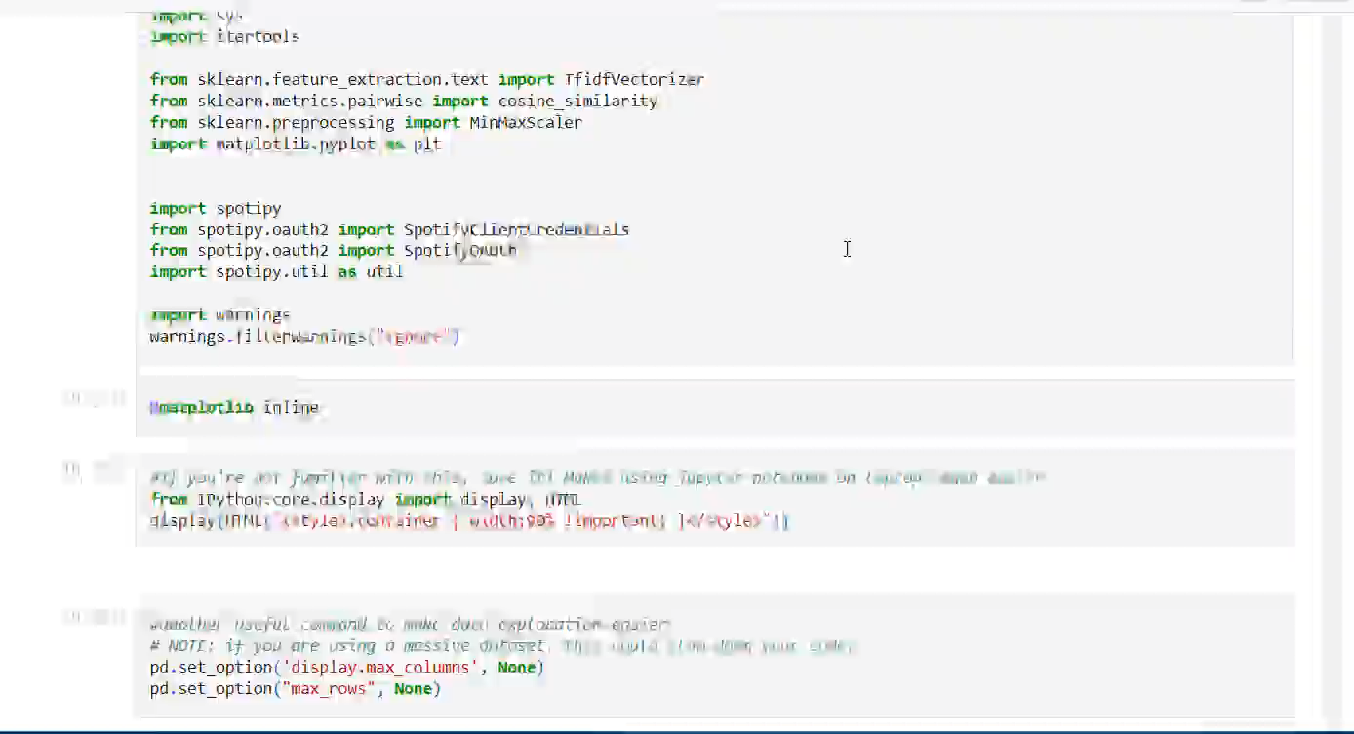
Video of Project Demo

Slide 9
Conclusion
The Spotify Music Recommendation System is a powerful tool that enhances user experience by providing personalized music recommendations tailored to individual preferences. Through advanced algorithms and machine learning techniques, Spotify analyzes user behavior, such as listening history, likes, and dislikes, to curate playlists and suggest songs that align with each user's taste.

Slide 10
Future Scope
Deep Learning Integration
Real-time Features
Enhanced Personalization
Social Integration
Advanced Analytics
System Optimization

Slide 11
Thank you!
Notes:
thank you very much for joining this PPT, keep learning.
11

